Slide 1
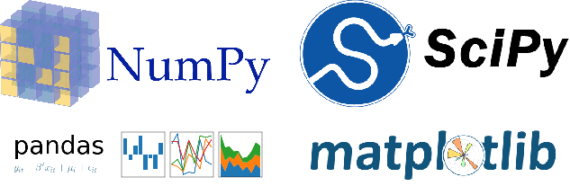
CEng 240 – Spring 2021 Week 12
Scientific and Engineering Libraries
Part 1: NumPy and SciPy
Sinan Kalkan

Slide 2
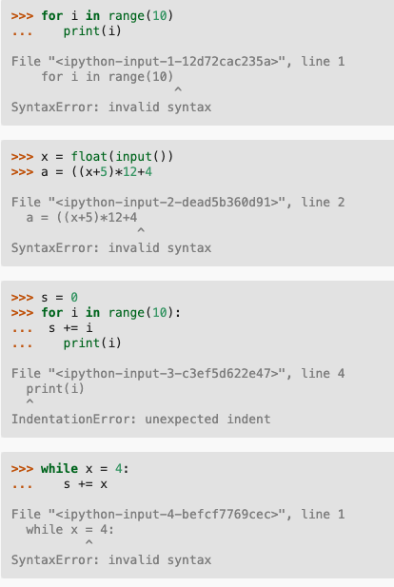
Error Types
Previously on CENG240!
Syntax errors
Type errors
Run-time errors
Logical errors

Slide 3
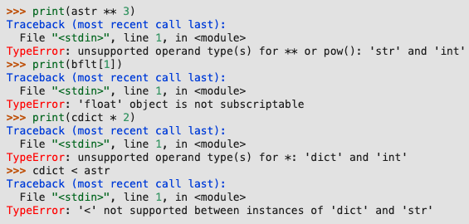
Error Types
Previously on CENG240!
Syntax errors
Type errors
Run-time errors
Logical errors

Slide 4
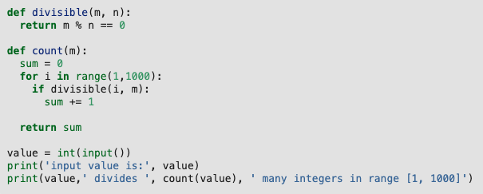
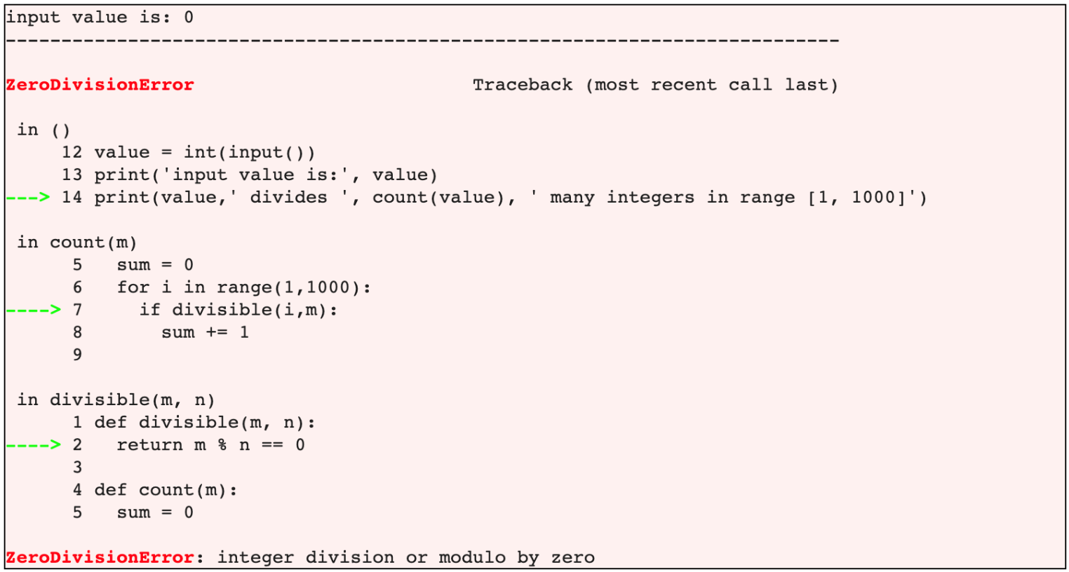
Error Types
Previously on CENG240!
Syntax errors
Type errors
Run-time errors
Logical errors

Slide 5
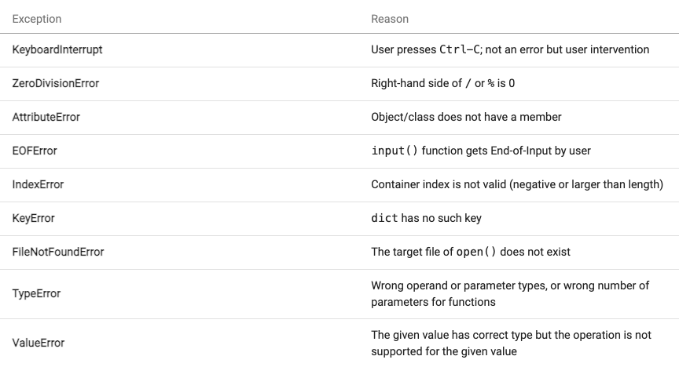
Exceptions
Previously on CENG240!

Slide 6
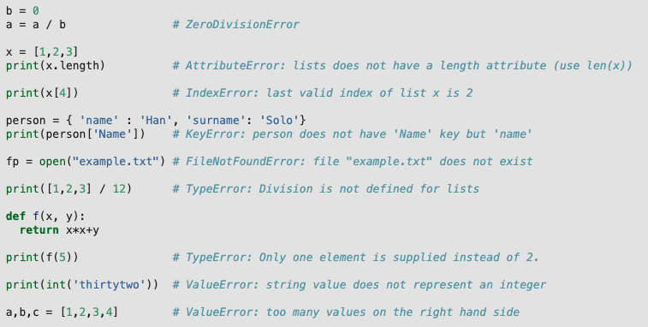
Exception Examples
Previously on CENG240!

Slide 7
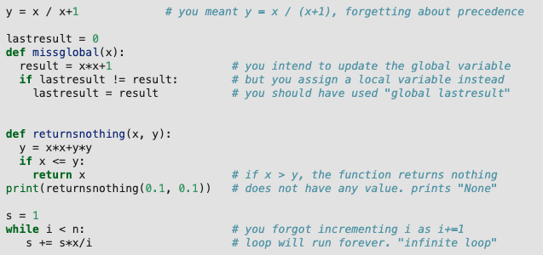
Error Types
Previously on CENG240!
Syntax errors
Type errors
Run-time errors
Logical errors

Slide 8
How to work with errors
Previously on CENG240!
Program with care
Place controls in your code
Handle exceptions
Write verification code & raise exceptions
Debug your code
Write test cases

Slide 9
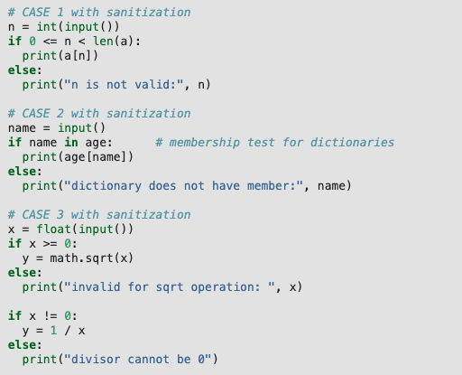
How to work with errors: (2) Place controls in your code
Previously on CENG240!

Slide 10
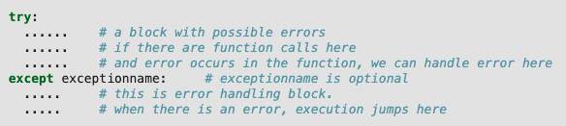
How to work with errors: (3) Handle Exceptions
Previously on CENG240!

Slide 11
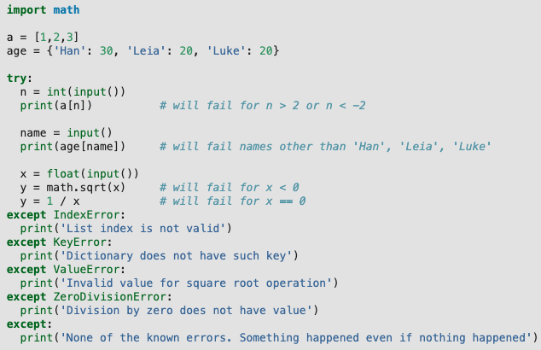
How to work with errors: (3) Handle Exceptions
Previously on CENG240!

Slide 12
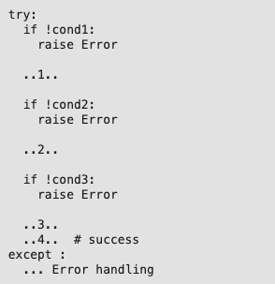
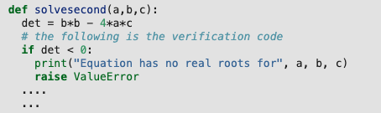
How to work with errors: (4) Write verification code and raise exception
Previously on CENG240!
You can raise exceptions
“raise Exception” => raise a generic exception

Slide 13

How to work with errors: (6) Write test cases
Previously on CENG240!

Slide 14
Debugging
Previously on CENG240!
Using debugging outputs
Handling exception and getting more info
Using debugger

Slide 15
Debugging: Using debugging outputs
Previously on CENG240!
The following code has a bug, how can we find it?
def sum_and_delete(L):
sum = 0
for i in range(len(L)):
sum += L[i]
del L[i]
return sum
sum_and_delete([1, 2, 3, 4, 5])

Slide 16
Debugging: Handling Exception to Get More Info
Previously on CENG240!
def sum_and_delete(L):
sum = 0
try:
for i in range(len(L)):
sum += L[i]
del L[i]
except:
print(f"i: {i} len(L): {len(L)}")
return sum
sum_and_delete([1, 2, 3, 4, 5])

Slide 17
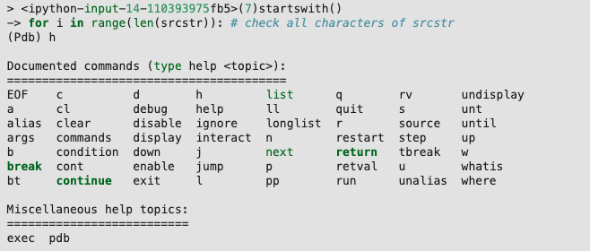
Debugging: Using debugger
Previously on CENG240!

Slide 18
Debugging: Using debugger
Previously on CENG240!
import pdb
def sum_and_delete(L):
sum = 0
pdb.set_trace()
for i in range(len(L)):
sum += L[i]
del L[i]
return sum
sum_and_delete([1, 2, 3, 4, 5])

Slide 19
This Week
Scientific and Engineering Libraries
NumPy for numerical computing
SciPy for scientific computing
Next week:
Pandas for data handling and analysis
Matplotlib for plotting

Slide 20


Slide 21
Outline
Overview
Installation
Arrays and their properties
Working with arrays
Linear algebra
Why use NumPy?

Slide 22
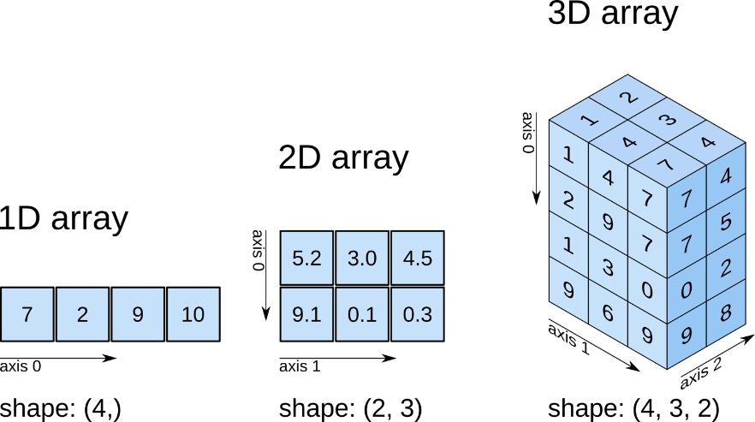
Overview
A Python library for arrays & matrices and mathematical functions that work on them.
Combination of two ancestor libraries in 2005: Numeric and Numarray.
Figure: https://www.oreilly.com/library/view/elegant-scipy/9781491922927/ch01.html

Slide 23
Installation
https://numpy.org/install/
On your Linux environment:
$ pip install numpy
or
$ conda install numpy
On Windows/Mac: install anaconda first
On Colab, it is already installed

Slide 24
Data types in NumPy
Integers:
np.int8, np.int16, np.int32, np.int64, np.uint8, ...
Float:
np.float16, np.float32, np.float64, ...
Complex:
np.complex64, np.complex128, ..
Boolean:
np.bool8
Default:
np.float64
For a full list, see: https://numpy.org/devdocs/user/basics.types.html

Slide 25
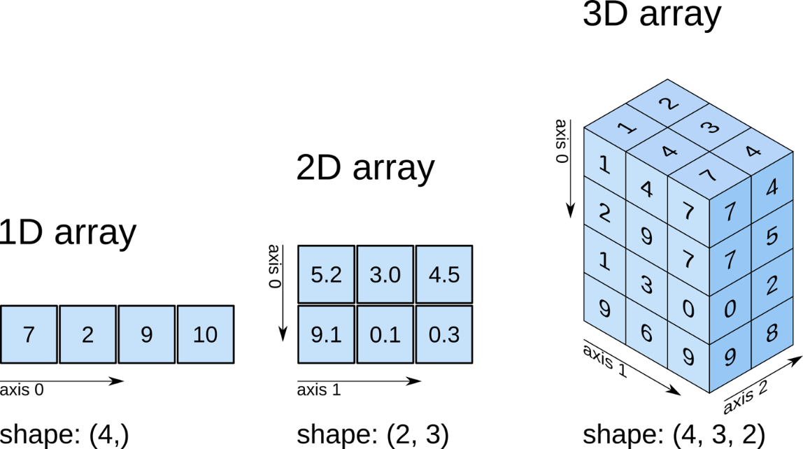
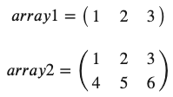
Arrays and their properties
In essence, NumPy is a library for n-dimensional arrays:
Figure: https://www.oreilly.com/library/view/elegant-scipy/9781491922927/ch01.html

Slide 26
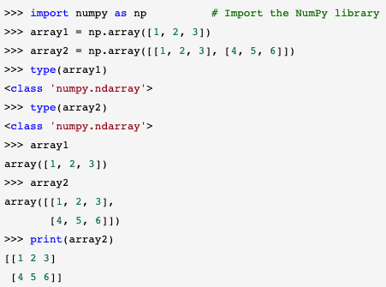
Arrays and their properties
Basic array creation

Slide 27

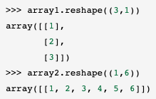
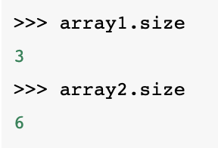
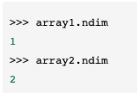
Arrays and their properties
Array Shapes, Dimensions, and Elements

Slide 28
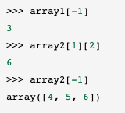
Arrays and their properties
Array Shapes, Dimensions, and Elements
Same indexing mechanisms of Python:
array2[1, 2] is also possible.

Slide 29
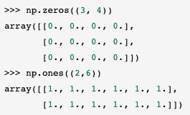
Arrays and their properties
Creating arrays
With the constructor:
np.array(<List>)
Arrays with constant values:
np.zeros(<shape>)
np.ones(<shape>)

Slide 30
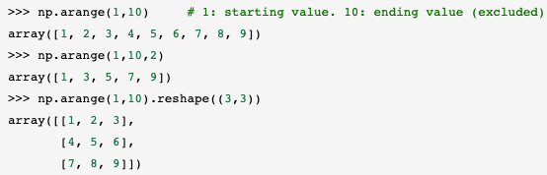
Arrays and their properties
Creating arrays
Array with a range of values:
np.arange(start, stop, step)
Random array:
np.random.randn(<shape>)

Slide 31
Working with arrays
Arithmetic, relational and membership operations
Mathematical functions
Splitting and combining arrays
Iterations with arrays

Slide 32
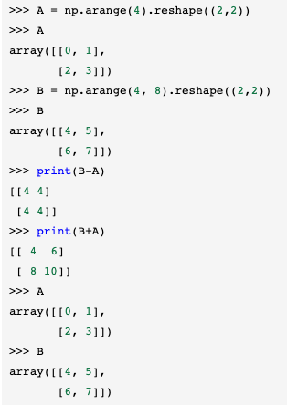
Working with arrays
Arithmetic, relational and membership operations
Arithmetic operations:
+, -, *, /, **
Be careful about the shapes of the arrays

Slide 33
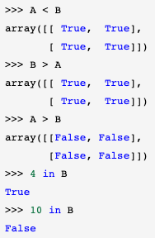
Working with arrays
Arithmetic, relational and membership operations
Relational operations:
==, <, <=, >, >=
Membership operations:
in, not in
Be careful about the shapes of the arrays

Slide 34
Working with arrays
Useful Functions
np.sqrt(<array>)
np.exp(<array>)
np.sin(<array>)
np.cos(<array>)
<array>.min()
<array>.max()
<array>.sum()
<array>.mean()
<array>.std()

Slide 35
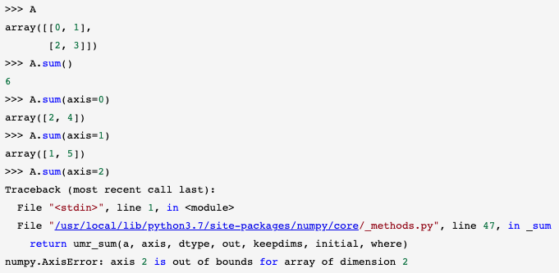
Working with arrays
Useful Functions
You may apply some of these operations on the whole array or along an axis

Slide 36
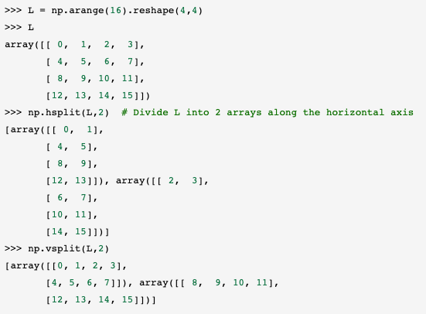
Working with arrays
Splitting and Combining Arrays
Splitting:
horizontal split (np.hsplit)
vertical split (np.vsplit)
general splitting (np.array_split)

Slide 37
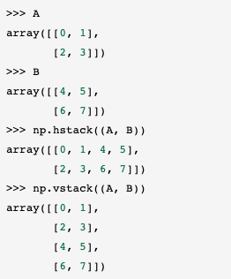
Working with arrays
Splitting and Combining Arrays
Combining:
horizontal stack (np.hstack)
vertical stack (np.vstack)
general stack (np.stack)

Slide 38
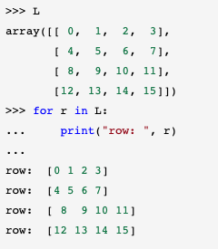
Working with arrays
Iterations with Arrays
You can use NumPy arrays in iterations as we would be using other container data types

Slide 39
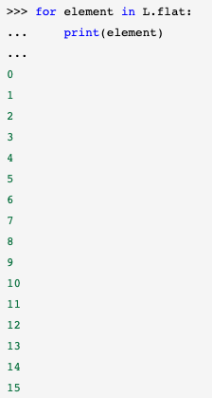
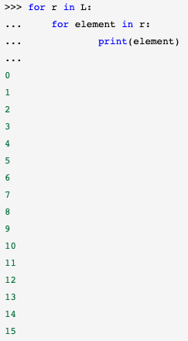
Working with arrays
Iterations with Arrays

Slide 40
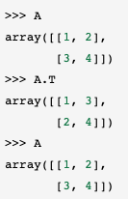
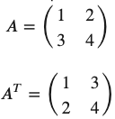
Linear algebra with NumPy
Transpose
<array>.T or <array>.transpose()
Original array does not change!

Slide 41
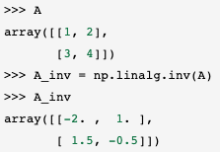


Linear algebra with NumPy
Inverse
np.linalg.inv(<array>)
Let’s check correctness:

Slide 42
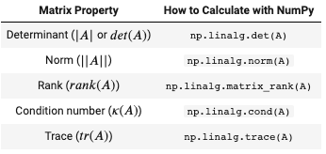
Linear algebra with NumPy
Determinant, norm, rank, condition number, trace

Slide 43
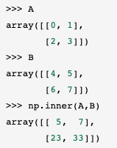
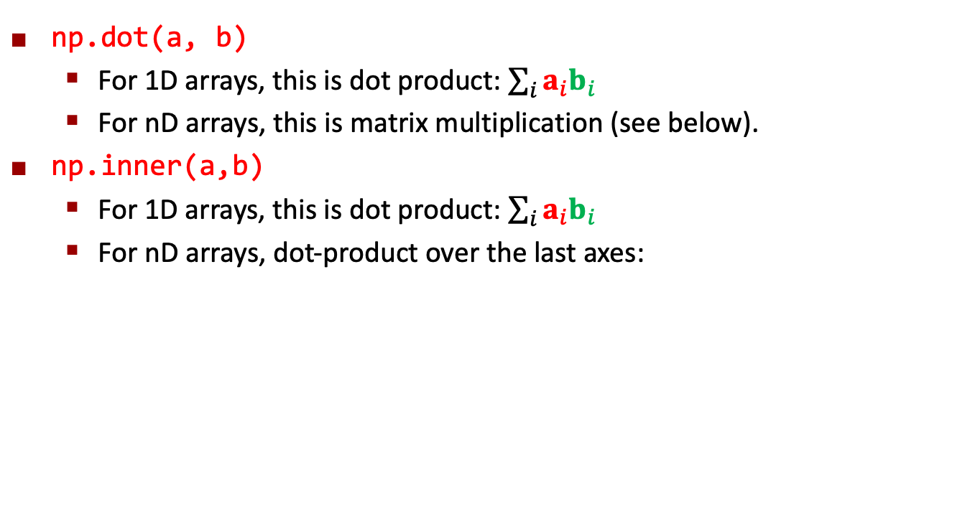
Linear algebra with NumPy
Dot product, inner product, outer product, matrix multiplication
np.dot(a, b)
For 1D arrays, this is dot product: $\sum_{i}{a_{i}b_{i}}$
For nD arrays, this is matrix multiplication (see below).
np.inner(a,b)
For 1D arrays, this is dot product: $\sum_{i}{a_{i}b_{i}}$
For nD arrays, dot-product over the last axes:
0 | 1
2 | 3
4 | 5
6 | 7
5 | 7
23 | 33
Dot product
E.g.:
.
0 | 1
4 | 5
= 5

Slide 44
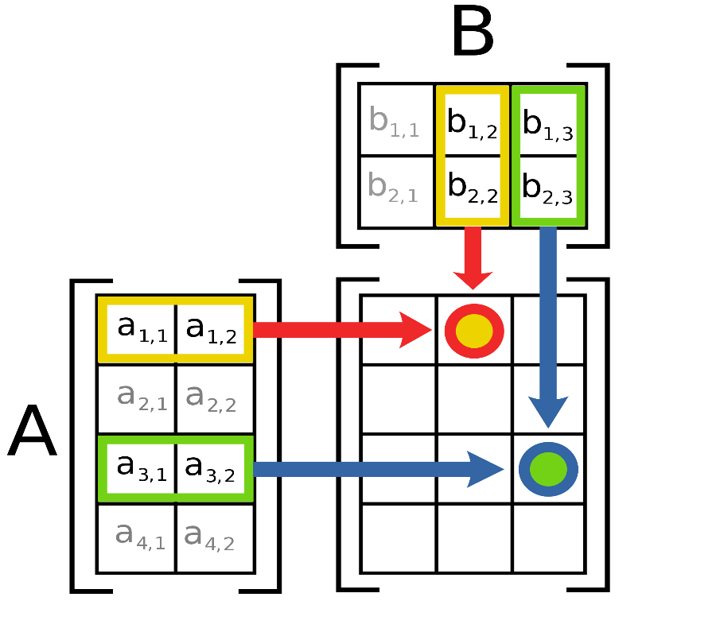
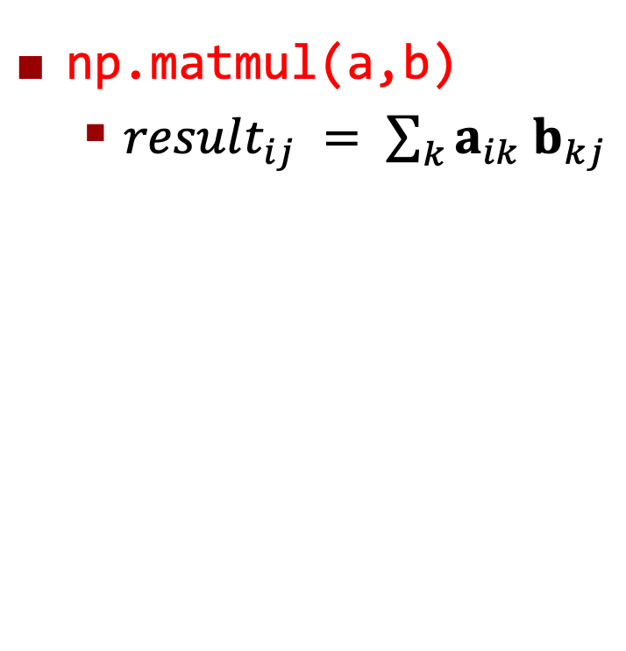
Linear algebra with NumPy
Dot product, inner product, outer product, matrix multiplication
np.matmul(a,b)
$result_{ij} = \sum_{k}{a_{ik} b_{kj}}$
Figure source: Wikipedia

Slide 45

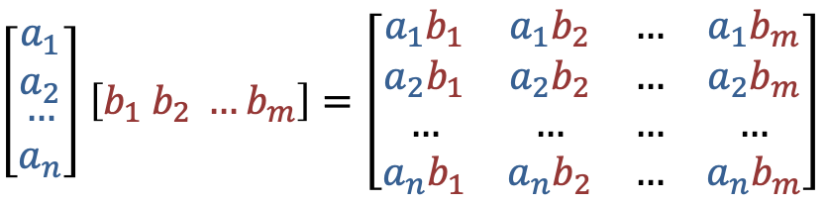
Linear algebra with NumPy
Dot product, inner product, outer product, matrix multiplication
np.outer(a,b):
Defined over vectors (1D arrays)
equivalent to matrix multiplication with ${ab}^{T}$
$result_{ij}=a_{i}b_{j}$
$\left[\begin{matrix}a_{1} \\ a_{2} \\ \begin{aligned}… \\ a_{n}\end{aligned}\end{matrix}\right]$ $\left[b_{1} b_{2} …b_{m}\right]=\left[\begin{matrix}a_{1}b_{1} & a_{1}b_{2} & … & a_{1}b_{m} \\ a_{2}b_{1} & a_{2}b_{2} & … & a_{2}b_{m} \\ … & … & … & … \\ a_{n}b_{1} & a_{n}b_{2} & … & a_{n}b_{m}\end{matrix}\right]$

Slide 46
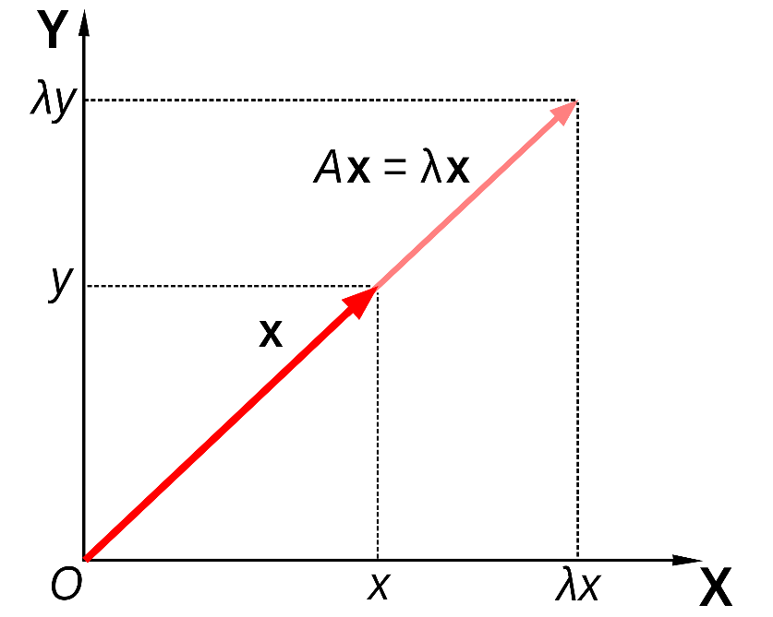

Linear algebra with NumPy
Eigenvectors and Eigenvalues
$$Ax=λx$$
matrix
eigenvector
eigenvalue
Figure source: https://en.wikipedia.org/wiki/Eigenvalues_and_eigenvectors

Slide 47
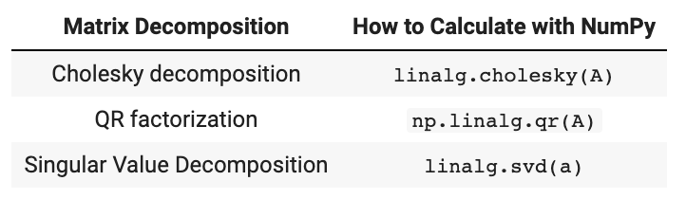
Linear algebra with NumPy
Matrix Decomposition
Matrix decomposition is highly used in solving problems in linear algebra

Slide 48
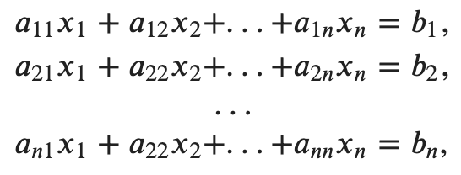
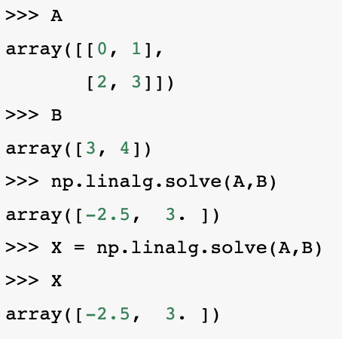

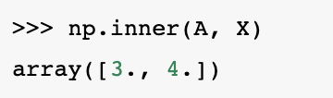
Linear algebra with NumPy
Solving a linear system of equations
We can use np.linalg.solve(a,b), e.g.:
which can be rewritten in matrix form as:
We can verify the solution by checking whether AX=B:

Slide 49
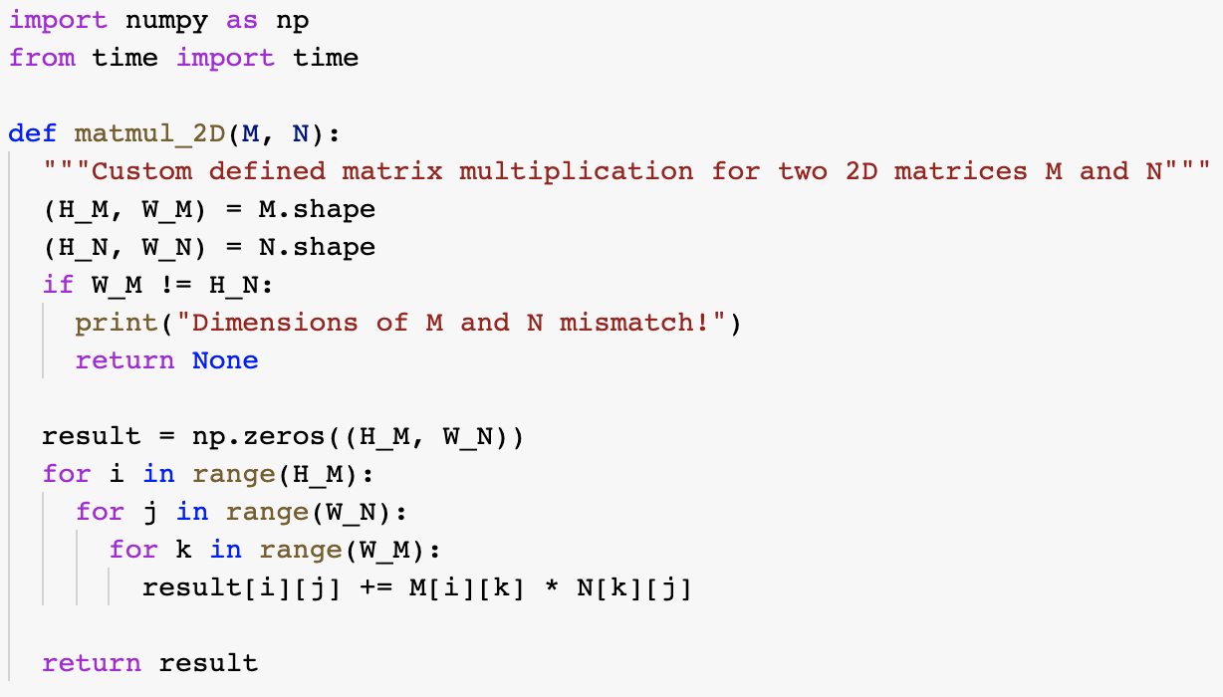
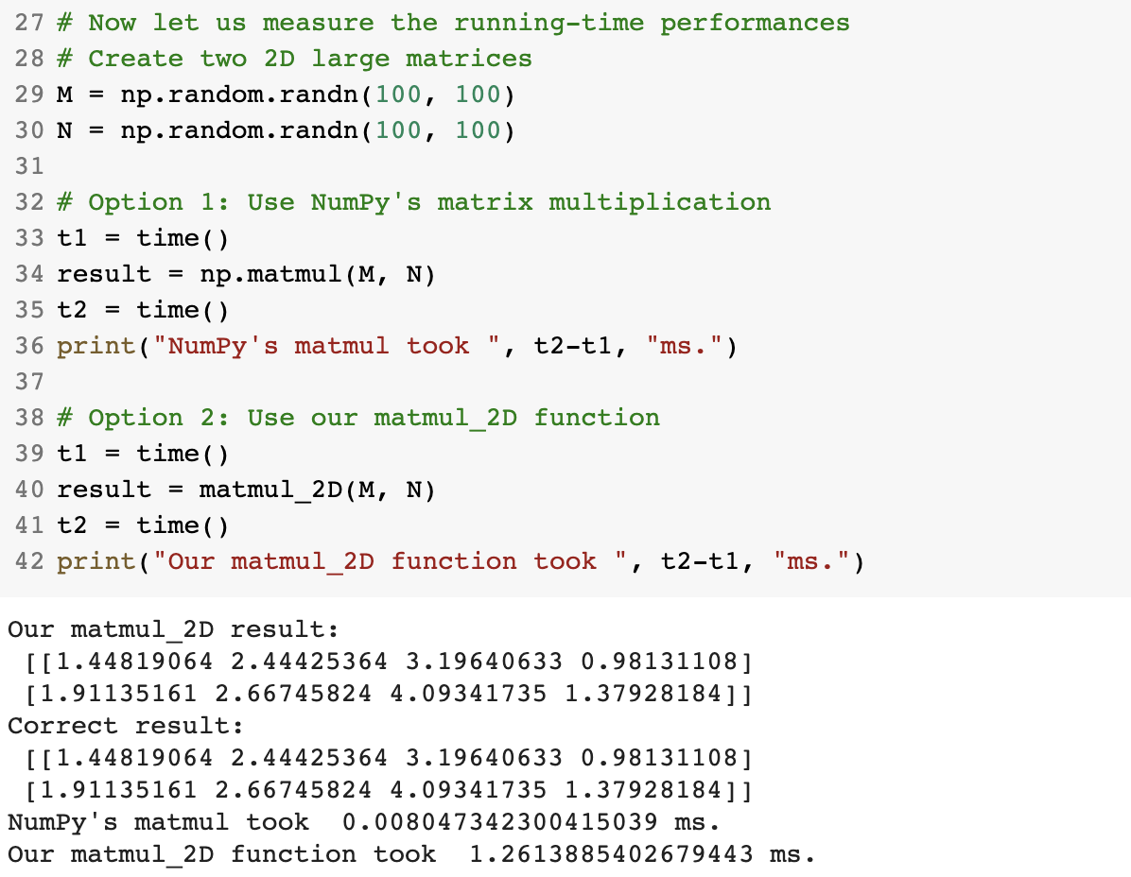
Why Use NumPy?
We can implement all functionalities of NumPy using Python datatypes and functions.
E.g. matrix multiplication is just an iteration over the elements of two arrays.
However, all such NumPy operations are implemented in C. Therefore, they are faster.
~1000 times difference in speed!

Slide 50


Slide 51
Outline
Overview
Installation
Modules

Slide 52
Overview
A library for Scientific Computing.
Clustering, Fourier Transforms, Integration & differential equation solving, Linear Algebra, Optimization, Image processing ...
It is closely linked with NumPy so much that NumPy needs to be imported first to be able to use SciPy.

Slide 53
Installation
On your Linux environment:
$ pip install scipy
or
$ conda install scipy
On Windows/Mac: install anaconda first
On Colab, it is already installed

Slide 54
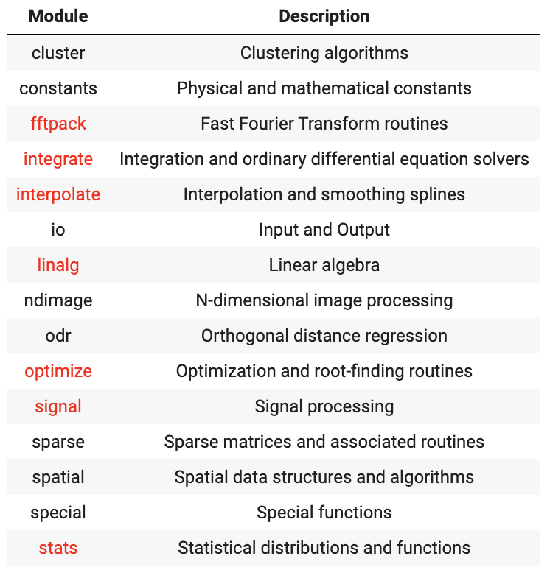
Modules

Slide 55
Examples
From the book:
“Define functions that work like the sum, mean, min and max operations provided by NumPy. These functions should take a single 2D array and return the result as a number. You can assume that the operation applies to the whole array and not to a single axis.”

Slide 56
Final Words: Important Concepts
NumPy arrays and their properties: array shape, dimensions, sizes, elements.
Accessing and modifying elements of a NumPy array.
Simple algebraic functions on NumPy arrays.
SciPy and its basic capabilities.

Slide 57
that’s all folks! Stay healthy

